Slide 1
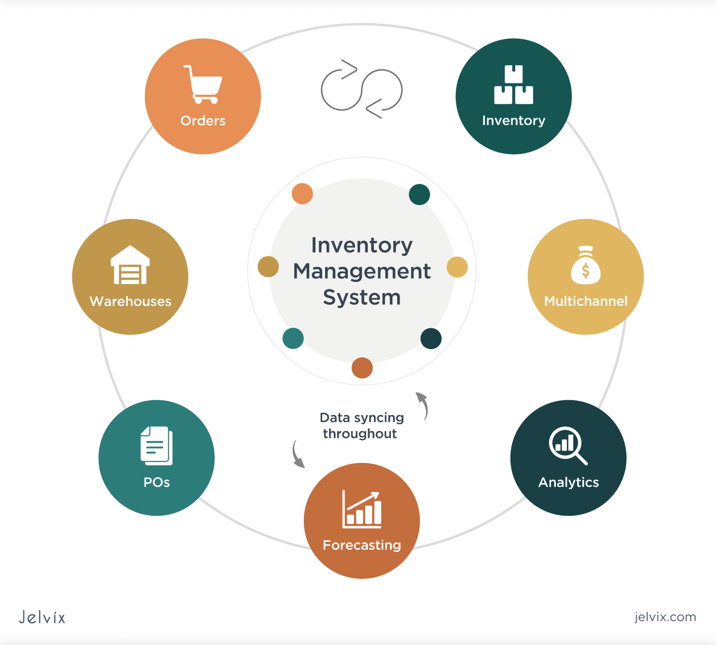


WELCOME !!!

Slide 2
Submitted By
Name | Id
Abir Hasan | 22303364

Slide 3
TABLE OF CONTENTS
01
02
What is IMS?
What can it do?
03
04
How can I build it?
Our Project

Slide 4
01
WHAT IS IMS?
Notes:
A robust application that enables businesses to: Monitor stock levels in real-time, Manage purchase and sales orders, Generate reports for decision-making, Integrate with supplier databases

Slide 5
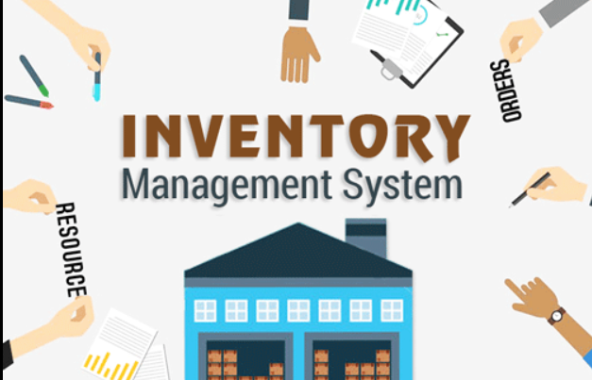
Inventory Management System
The project Inventory Management System is a complete desktop based application designed on Net
technology using Visual Studio Software.

Slide 6
Technology Stack
Frontend: HTML, CSS, JavaScript, Bootstrap
Backend: .NET MVC (C#), Entity Framework
Database: SQL Server

Slide 7
02
WHAT CAN IT DO?

Slide 8
WHAT CAN IT DO?
Stock tracking and updates
Order management (purchase/sales)
Supplier and customer management
Role-based user access

Slide 9
03
HOW CAN I
BUILD IT?

Slide 10
MVC Architecture:
The system follows the Model-View-Controller (MVC) pattern:
Model: Represents data and business logic (e.g., Product, Order entities)
View: User interface (Razor views with Bootstrap)
Controller: Handles user input and interactions
Database Design:
Tables: Item, Orders, Suppliers, User
Relationships: Managed via Entity Framework ORM

Slide 11
04
Our Project

Slide 12
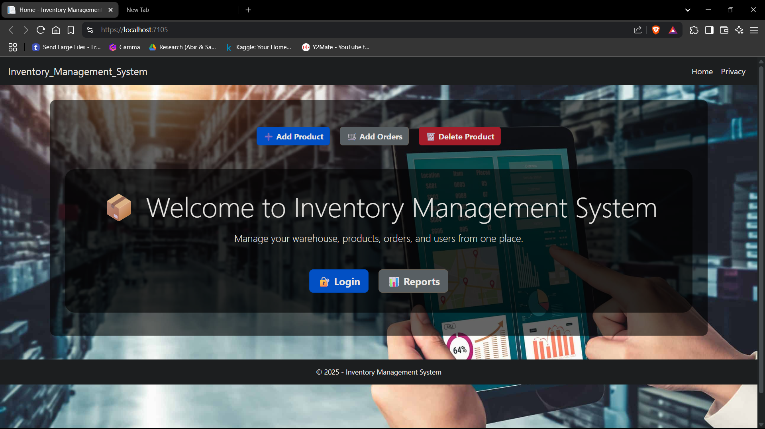
Home Page

Slide 13
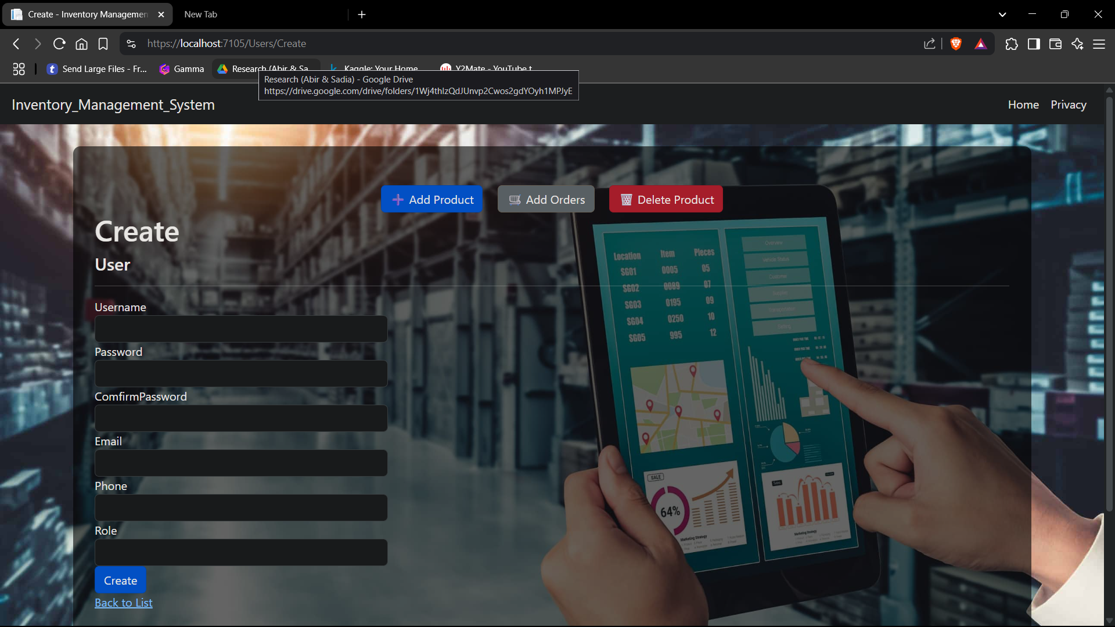
Add Users

Slide 14
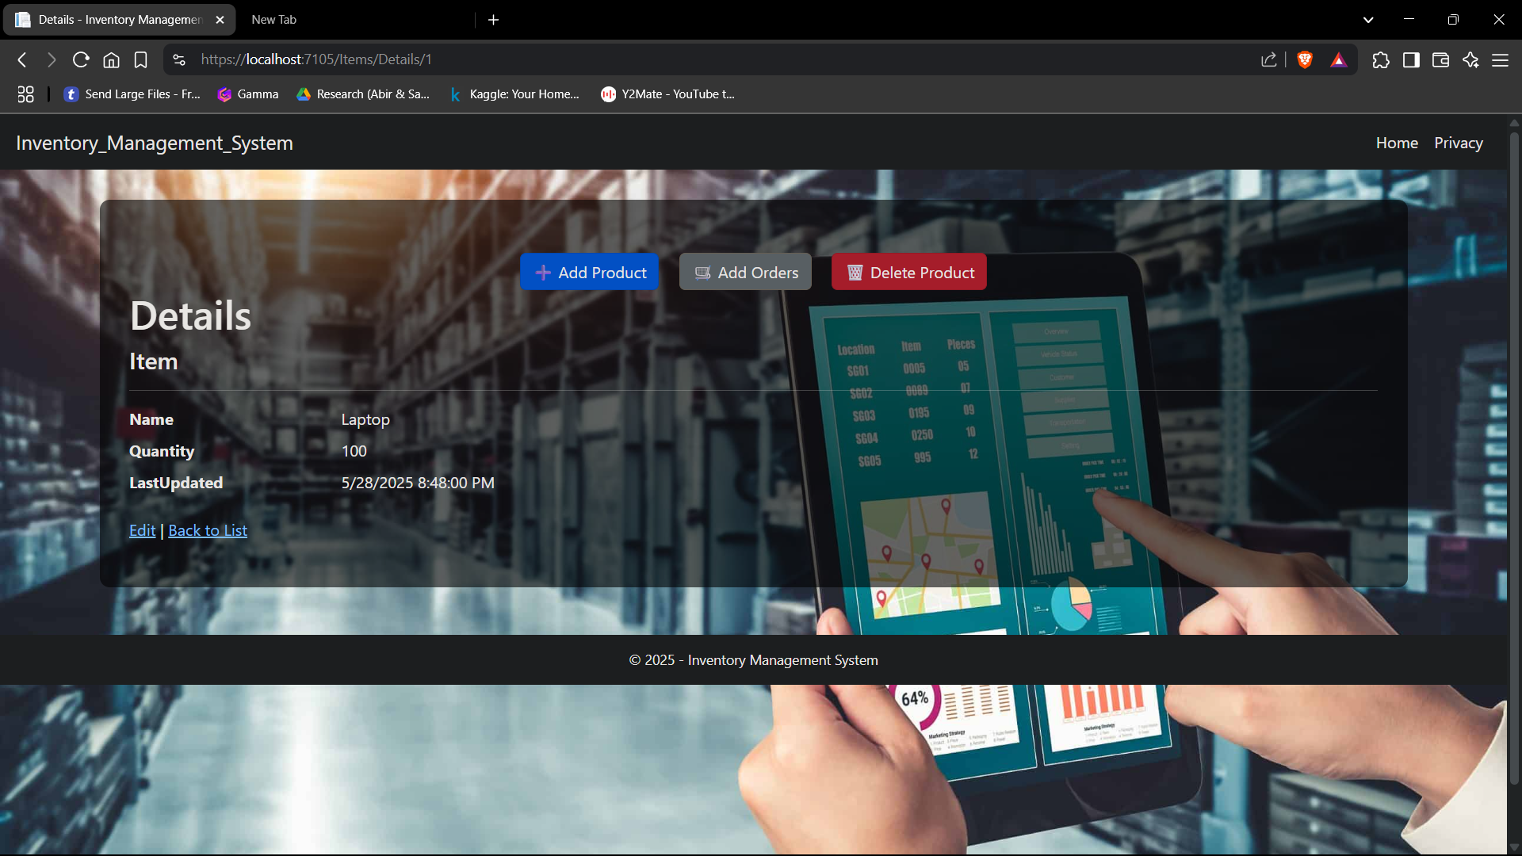
View Products

Slide 15
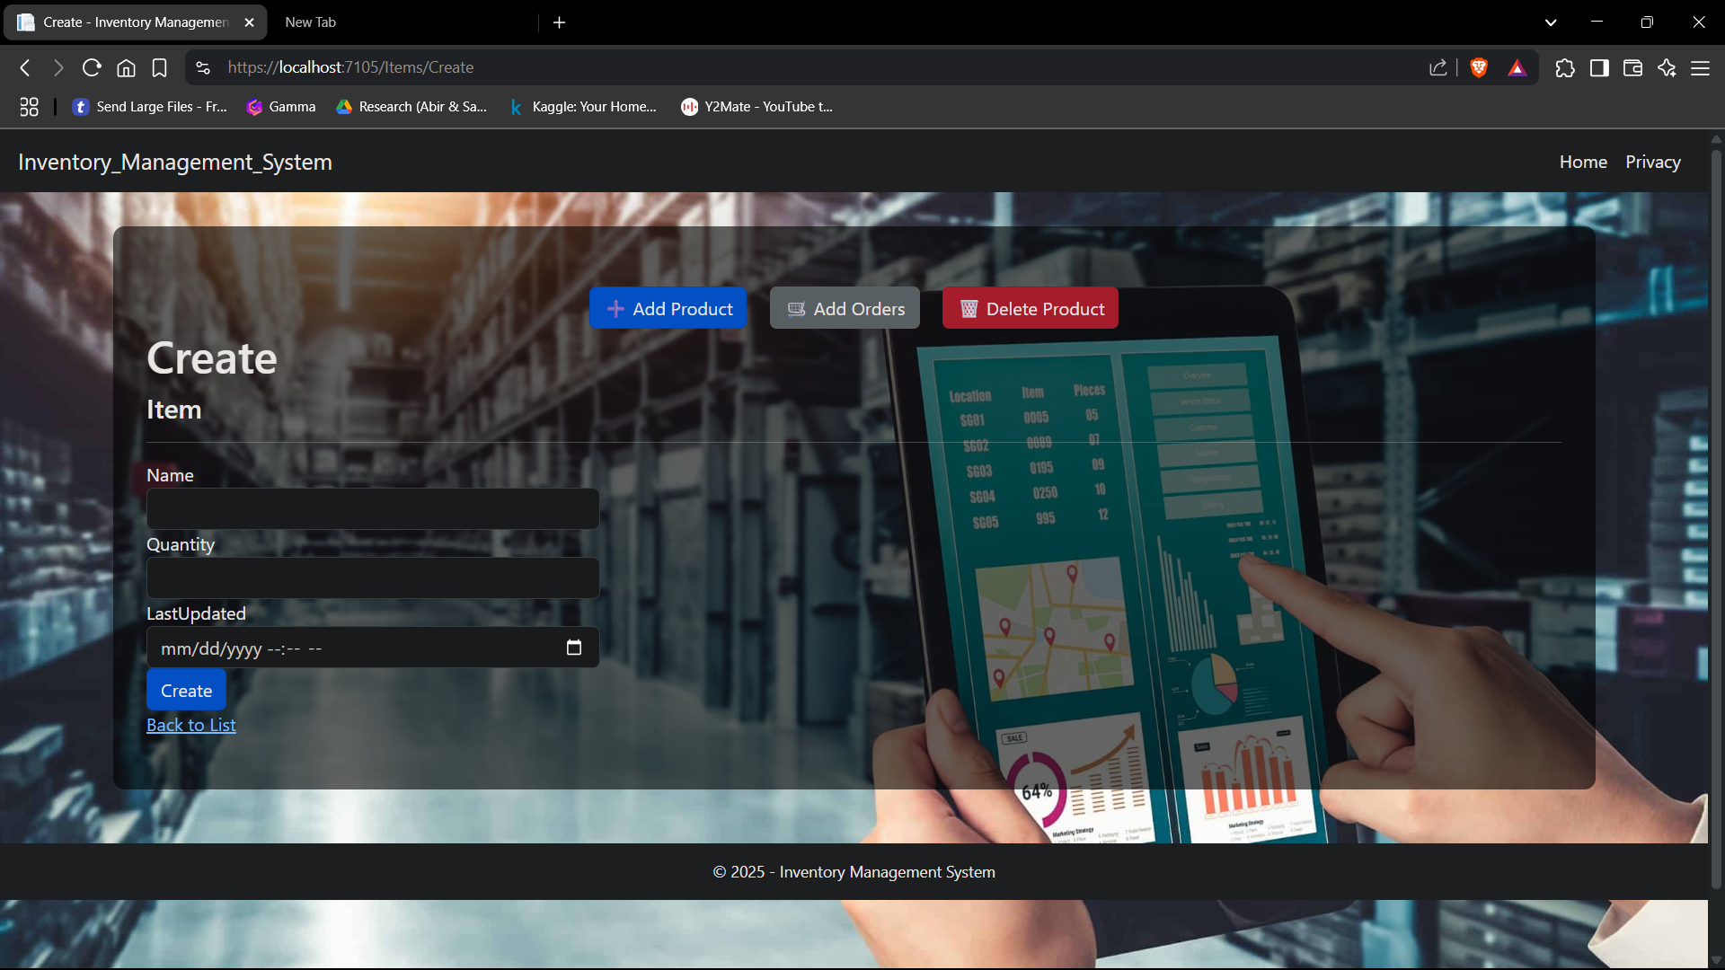
Add Products

Slide 16
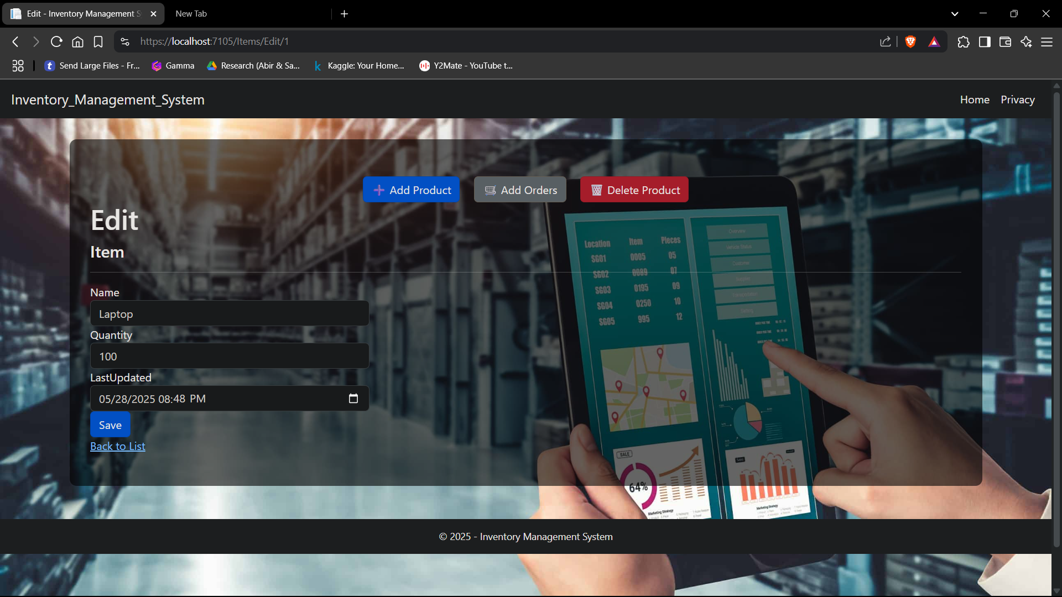
Update Data

Slide 17
Conclusion
In conclusion, the development and implementation of an Inventory Management System (IMS) represent
a significant step towards enhancing the efficiency and effectiveness of inventory control within
organizations. Through the utilization of modern technologies, including Database Management Systems
(DBMS), businesses can streamline their inventory processes, optimize resource utilization, and improve
decision-making capabilities.

Slide 18
THANK YOU!
DO YOU HAVE ANY QUESTIONS?

